Slide 1

IV. High speed performance
Notes:
In section I, basics of straight and steady level flight have been presented, with one major hypothesis : incompressible drag polar, aerodynamic coefficients being independent from Mach number.
In this section, the influence of Mach number on aircraft performance in straight and steady level flight are addressed.

Slide 2
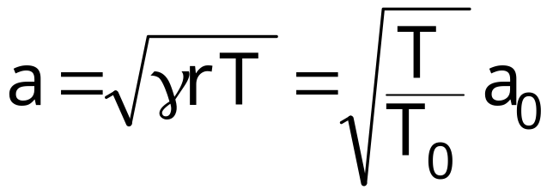
1. Mach number
Mach number, M, is the ratio between True Airspeed, V, and sound velocity, a :
  V = a M
Sound velocity, noted a, is a function of temperature only :
Numerical values :
  = 1.4 and r = 287.05 J/kg/K
  At seal level, in ISA conditions :
    T₀ = 288.15 K ⇒ a₀ = 340.29 m/s = 661.48 kt
Notes:
Mach number is essential for transonic and supersonic flight since aerodynamic characteristics may change drastically according to Mach number.
a₀ is the sound velocity at sea level under ISA conditions (15°C / 288.15 K temperature).

Slide 3
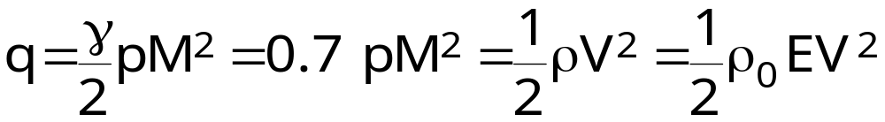
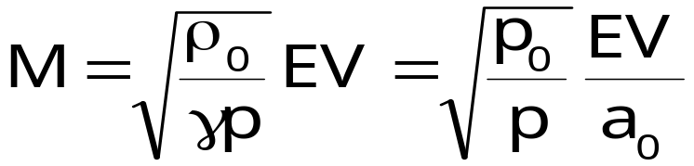
1. Mach number
Kinetic pressure, q, may be expressed as a function of static pressure, p, and Mach number :
Mach number is a function of equivalent airspeed (EV), and static pressure :
  When pressure altitude increases at constant equivalent airspeed, Mach number increases.
Notes:
Kinetic pressure may be expressed as a function of Mach number. This expression is obtained replacing air density ρ according to Mariotte’s law and true airspeed, V, by its expression function of sound velocity and Mach number :
The expression of Mach number, as a function of equivalent airspeed is derived from the expressions of kinetic pressure as functions of Mach number and equivalent airspeed.

Slide 4
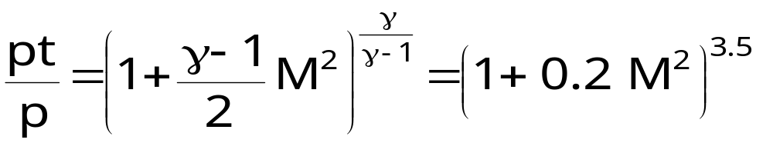
1. Mach number
Total pressure and static pressure
Static port
Pitot tube
Total pressure pt
(total temperature Tt)
p
pt
Static pressure p
(static temperature T)
According to Saint-Venant’s formula, the ratio between total pressure and static pressure is a function of Mach number
Notes:
Total pressure (also called stagnation pressure) is the pressure obtained when airflow is slowed down to zero airspeed : at stagnation points (for example at the wing leading edge). A pitot tube captures total pressure. At stagnation points, temperature is total temperature.
Saint-Venant’s formula for total pressure is applicable to isentropic flow. The flow is isentropic (constant total pressure) when there are no shock waves, out of viscous phenomena (boundary layer, separated flow or wake) and when no energy is added to the flow (outside propeller wake or engine exhaust jets).
Bernoulli’s equation for isentropic incompressible flow presented in section I, is valid at low Mach numbers : it can be obtained from a first order development of Saint-Venant’s formula or total pressure.
To capture the total pressure, in subsonic flow, a pitot tube must be placed out of the boundary layer, avoiding separated flow and propeller wake.
Another formula, also from Saint-Venant, allows to express total temperature as a function of static temperature :
Termes français : pt est la pression totale, également dénommée pression génératrice (soufflerie) et parfois pression d’impact.

Slide 5
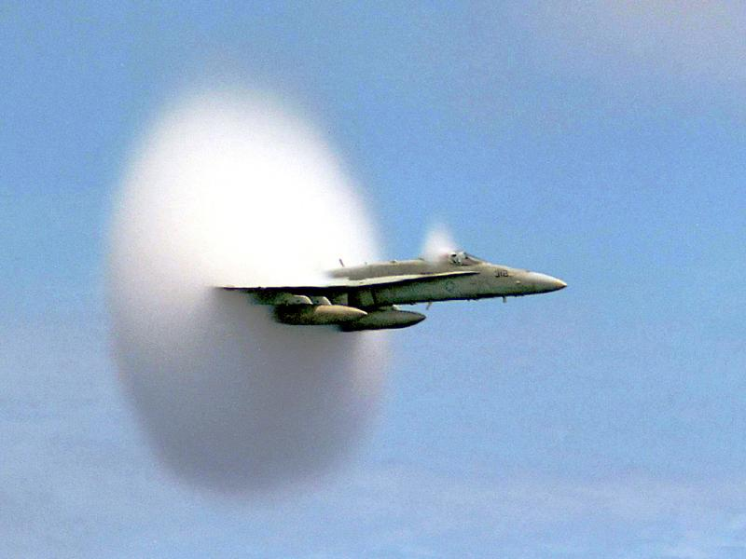
2. Transonic and supersonic aerodynamics
Notes:
IV - <number>
Issue 1 – Feb 2011
IV – High speed performance
The influence of Mach number on aerodynamic coefficients is limited in the subsonic domain, when the local velocities around the airplane are subsonic, but becomes significant in the transonic domain, when local supersonic flow appear, and furthermore when there are shock waves.
On this picture, local supersonic flow areas are materialized by water vapor condensation. The abrupt end of the main supersonic flow zone, due to the wing, is an indication of a shock wave.
A shock-wave is a compression : through the shock line, static pressures increases while total pressure decreases (total temperature does not changes). The consequence of the loss total pressure is pressure drag.

Slide 6

2. Transonic and supersonic aerodynamics
Transonic drag divergence
Cx
0.04
Cz = 0.6
Cz = 0.4
Drag divergence : = 0.1
0.00
0.45
0.5
0.55
0.6
0.65
0,7
0.75
0.8
0.85
Mach
Notes:
IV - <number>
Issue 1 – Feb 2011
IV – High speed performance
Drag at constant lift coefficient : drag divergence in the transonic regime
At constant lift coefficient Cz, when Mach number increases, the drag coefficient Cx increases steeply above the drag divergence Mach number (M_{dx}) which is defined by :
When the lift coefficient increases, the drag divergence Mach number decreases.
Drag divergence is a major problem for high speed flight : above divergence Mach number the increase of drag requires increase of thrust (and fuel flow) to overcome the increase of drag.

Slide 7
2. Transonic and supersonic aerodynamics
Lift and drag coefficients in the transonic domain
Cz
Maximum lift coefficient Cz max
Stall / Buffeting limitation
Drag
divergence
1.0
ΔCx/Cx_{inc} 10 %
ΔCx/Cx_{inc} 1 %
0.0
0.2
0.3
0.4
0.5
0.6
0.7
0.8
0.9
Mach
Notes:
IV - <number>
Issue 1 – Feb 2011
IV – High speed performance
The slide presents a commercial jet maximum lift coefficient as a function of Mach number (along with drag divergence). In the transonic regime, the lift coefficient may be limited by phenomena such as buffeting, or by handling qualities instabilities.
Buffeting is produced by flow separation at the shock wave root. In the transonic regime, commercial jets lift coefficient is usually limited by deterrent buffet, as shown on the sketch above. Deterrent buffet is defined by a 1 « g » peak to peak vibration level at pilot’s seat.
Fighters lift coefficient is usually limited by handling qualities instabilities, such as pitch-up or lateral instabilities.

Slide 8

2. Transonic and supersonic aerodynamics
Air intakes : internal flow in supersonic flight
Subsonic cruise
A₀
A₁
ε = < 1
V
Supersonic cruise
M > 1
M < 1
V
Shock wave
Notes:
IV - <number>
Issue 1 – Feb 2011
IV – High speed performance
This slide presents internal flow in an air intake in subsonic flight and in supersonic flight.
In supersonic flight, the internal flow is subsonic. In a pitot air intake, as shown above, the flow behind the normal shock wave is subsonic.
However, the efficiency of pitot intakes, decreases drastically in supersonic flight, due to the loss of total pressure through a normal shock. The efficiency is the ratio between total pressure downstream and upstream of the air inlet.
That is why most supersonic air inlets have more complex shapes : compression is achieved through several oblique shock waves, in order to increase efficiency (intake efficiency is defined as the ratio between internal total pressure and upstream total pressure).
The sketch below presents the principle of a bidimensional supersonic air inlet : a first oblique shock develops at the front, and is followed by a final normal shock, at Mach number slightly above 1, which minimizes the total pressure losses.

Slide 9
3. Calibrated air speed (CAS)
Pitot tube
Static port
p
pt
Δp = pt - p
At high Mach numbers, Bernoulli’s equation is not valid
Δp/p is a function of Mach number
  Consequence of Saint Venant’s equation
  Mach number may be obtained from pt/p or from Δp/p
Notes:
Δp is the difference between total pressure and static pressure. It is sometimes called dynamic pressure.
Saint-Venant’s formula may be used to express Δp as a function of static pressure p and Mach number M :
Δp = pt – p = p {(1 + 0.2 M²)^{3.5} – 1} = Δp (M)
A first order development of this formula, valid at low Mach numbers is :
Δp = pt – p = p {1 + 0.7 M² – 1} = 0.7 p M² = q
This corresponds to Bernoulli’s equation and the expression used in section I.
In supersonic flow, a normal shock wave develops at the front of the pitot tube. As a consequence, flow is no longer isentropic. But, downstream flow parameters (Mach number and total pressure) are functions of upstream flow parameters (Mach number and total pressure). So, we can still express Δp as a function of Mach number and static pressure, using a more complex expression, taking into account the normal shock at the pitot tube.

Slide 10
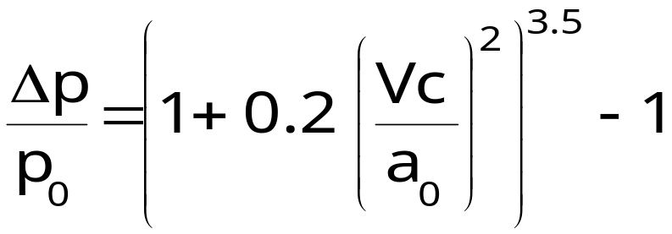
3. Calibrated air speed (CAS)
Calibrated airspeed, noted Vc, is a function of Δp, valid for all Mach numbers
At sea level, in ISA conditions, calibrated airspeed and true airspeed are equal
At subsonic speeds, CAS, noted Vc is obtained from the expression for Δp/p as a function of Mach number, replacing p by p₀ and M by Vc/a₀ :
  Note : expression valid only for Vc < a₀
Notes:
The airspeed indicator is a differential manometer measuring the pressure differential Δp and converting it in an airspeed information, the Calibrated Airspeed (abbreviation CAS, noted Vc) :
Vc = Vc (Δp)
Calibrated Airspeed is the main airspeed information used by the pilot to control the airplane.
The law for Calibrated Airspeed definition is based on the expression for the pressure differential Δp as a function of Mach number and static pressure. Calibrated Airspeed is defined in order to be equal to True Airspeed (and Equivalent Airspeed) at sea level under ISA conditions :
a₀ and p₀ are the ISA reference values for sound velocity and static pressure at sea level (a₀ = 661.48 kt and p₀ = 101325 Pa).
The expression for Calibrated Airspeed is presented on the slide for subsonic flow (Calibrated Airspeed lower than a₀ = 661.48 kt). For Vc greater than a₀, the supersonic expression for Calibrated Airspeed must be used, taking into account the loss of total pressure du to normal shock at the front of the pitot tube.
The indicated airspeed (abbreviation IAS, noted Vi) takes into account airspeed errors presented in section I of the course.
Terme français : L’anémomètre, également dénommé Badin correspond à l’ « Air Speed Indicator » et la vitesse conventionnelle est la traduction de « calibrated airspeed ».

Slide 11
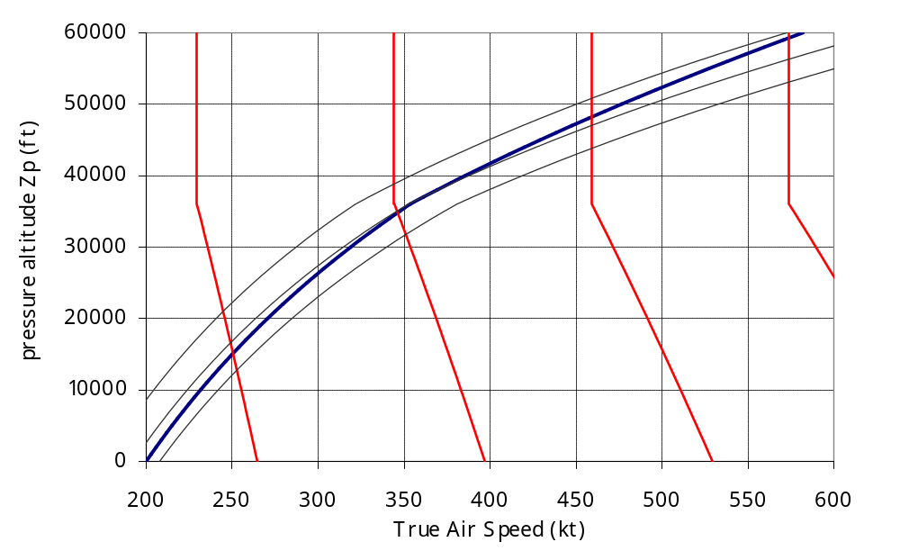
3. Calibrated air speed (CAS)
Mach 0.4
Mach 0.6
Mach 0.8
q 6000 Pa
q 7000 Pa
CAS 200 kt
Mach 1.0
q 5000 Pa
At 200 kt CAS, TAS is :
200 kt at sea level
319 kt at 30 000 ft
582 kt at 60 000 ft
!
Diagram valid only in ISA conditions
Notes:
This slide shows constant calibrated airspeed 200 kt line in the true airspeed, pressure altitude domain (in ISA conditions). Constant Mach number and constant kinetic pressure lines are also presented.
When altitude increases, at constant calibrated airspeed :
True Airspeed increases
Mach number increases
Kinetic pressure decreases slowly
It should be noticed that, for a constant calibrated airspeed and pressure altitude Zp :
Mach number does not depend on temperature, and, as a consequence kinetic pressure (q = 0.7 p M²) does not depend on altitude.
true airspeed depends on temperature (V = aM), since the speed of sound, a, is a function of temperature only. As a consequence, this diagram is valid only in ISA conditions.

Slide 12
3. Calibrated Airspeed (CAS)
Equivalent airspeed is a function of calibrated airspeed and pressure altitude :
  By definition, calibrated airspeed is a function of Δp : Vc (Δp)
  Δp is a function of Mach number and static pressure p (or Zp)
  As a consequence, calibrated airspeed may be expressed as a function of Mach and pressure-altitude : Vc (M, Zp)
  Kinetic pressure : q = 0.7 p M² = ½ρ₀ EV²
  Equivalent airspeed may be expressed as a function of calibrated airspeed and pressure altitude :
    EV (Vc, Zp)
Notes:
Using Saint-Venant’s law and normal shock relations, it is possible to express pressure differential Δp as a function of Mach number and static pressure p.
As a consequence, CAS may be expressed as a function of static pressure and Mach number :
For Vc ≤ a₀ :
In this expression, when replacing Mach number by its expression as a function of static pressure and equivalent airspeed, EV, we obtain :
Reversing this expression, we obtain equivalent airspeed as a function of calibrated airspeed and static pressure.

Slide 13
3. Calibrated Airspeed (CAS)
Compressibility factor :
  The compressibility factor, noted Kc, is the ratio between equivalent airspeed and calibrated airspeed :
  EV = Kc (Vc,Zp). Vc
  Kc is equal to 1 for Zp = 0, and lower than 1 for positive pressure-altitudes.
  At low altitudes Kc ≅ 1 (examples below) :
Zp | Vc | Kc
3 000 ft | 180 kt | 0.999
10 000 ft | 250 kt | 0.992
10 000 ft | 290 kt | 0.990
20 000 ft | 320 kt | 0.970
Notes:
Since equivalent airspeed may be expressed as a function of calibrated airspeed and pressure altitude Zp, the compressibility factor may also be expressed as a function of calibrated airspeed and Zp.
From calibrated airspeed definition, at zero pressure altitude, calibrated airspeed and equivalent airspeed are equal. Kc decreases when Zp increases.
In theory, Kc is greater than 1 when Zp is negative, but minimum values for Zp are close to – 1000 ft (-1000 ft corresponds to 1050 hPa). As a consequence, for negative pressure altitudes, Kc is very close to 1 (1,001 for 300 kt Vc and 1,004 at 700 kt).
Terme français : Kc est le coefficient de compressibilité.

Slide 14
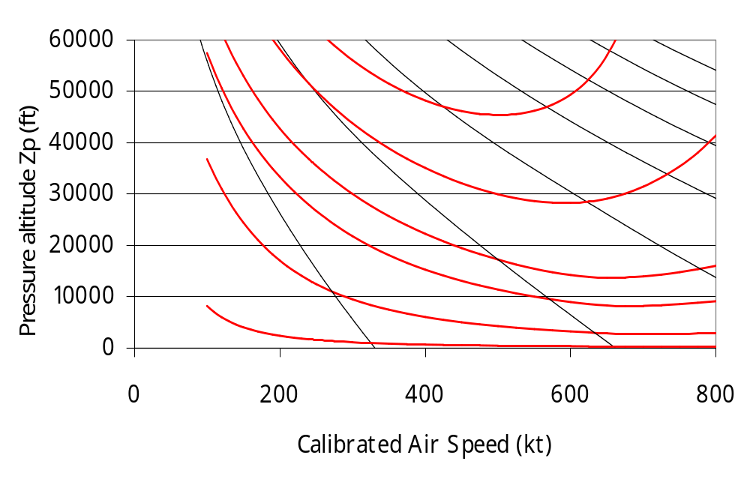
3. Calibrated Airspeed (CAS)
Compressibility factor
Mach 3.5
Mach 3.0
Kc 0.85
Mach 2.5
Mach 1.5
Mach 2.0
Kc 0.90
Mach 1.0
Mach 0.5
Kc 0.95
Kc 0.97
Kc 0.999
Kc 0.99
Notes:
This figure presents the lines for constant compressibility factor in the calibrated airspeed versus pressure altitude domain.
It should be noticed that for Mach lower than 0.5, the compressibility factor is higher than 0.97, the difference between equivalent airspeed and calibrated airspeed being lower than 3 %. This figure justifies the approximation used in section I : at low altitudes and low speeds, compressibility factor may be approximated by 1. It should be stressed that airworthiness regulations allow a 3 % error between indicated airspeed and calibrated airspeed.
In the subsonic domain (Mach lower than 1), the minimum value for Kc is 0.9.
Terme français : Kc est le coefficient de compressibilité.

Slide 15
3. Calibrated Airspeed (CAS)
Summary of speed definitions
Ground speed | GS | Vk | Aircraft velocity, relative to ground
True Airspeed | TAS | V | Aircraft velocity, relative to the air
Mach number |  | M | Ratio between TAS and speed of sound (a)
Equivalent Air Speed | EAS | EV | Airspeed corresponding to a given kinetic pressure at sea level in ISA conditions
Calibrated Air Speed | CAS | Vc | Airspeed corresponding to a given pressure differential, at sea level, in ISA conditions
Compressibility factor |  | Kc | Ratio between EAS and CAS
Indicated Air Speed | IAS | Vi | Indication of CAS, including airspeed errors
Notes:
This slide presents the basic definitions concerning speed.
Termes français (rappel) :
GS : Vitesse sol
TAS : Vitesse propre
EAS : Équivalent de vitesse
CAS : Vitesse conventionnelle
Kc : Coefficient de compressibilité
IAS : Vitesse indiquée

Slide 16
3. Calibrated Airspeed (CAS)
Altitude and speed informations
Basic informations
Static pressure
p
Zp
Pressure altitude
Pressure differential
Δp
Vc
Calibrated airspeed
Other informations
Mach number
True airspeed
Δp
M
T
V
p
Total temperature
Tt
M
T
Static temperature
Notes:
The altimeter and the airspeed indicator are « simple » instruments providing basic flight information :
Pressure altitude Zp is a function of static pressure p only,
Calibrated airspeed (or more precisely Indicated Air Speed) is a function of the pressure differential Δp.
When combined together, static pressure and pressure differential allow to obtain Mach number.
This may also be used to compute kinetic pressure or equivalent air speed.
Static temperature may be obtained from total temperature, measured by a temperature probe, and Mach number.
True airspeed may then be derived from Mach number and static temperature.
Note : A temperature probe does not measure exactly the TAT. The measured temperature is Tm, defined by the following equation, where kr is the recovery factor, which is lower than 1 :
Tm = (1 + 0.2 kr M²)T
Recovery factors for TAT probes (which are heated to avoid icing) are usually higher than 0.98.

Slide 17
3. Calibrated Airspeed (CAS)
« Speed tape » on Primary Flight Display (PFD)
360
340
Maximum speed : VMO or MMO
320
IAS (kt)
300
Speed trend
280
Mach
0.821
Notes:
This slide presents the airspeed indications on a primary flight display (or PFD), which presents primary flight information including airspeed, altitude, heading and altitude, in a single display.
Usually, indicated airspeed, is presented as the primary information for speed, on a speed tape.
Airspeed limitations are usually presented on the speed tape : maximum airspeed according to relevant configuration and altitude (VMO, MMO or VFE). Minimum speeds are also displayed (not shown on the figure).
The Mach number may also be displayed on the PFD, usually below the speed tape, as on the figure on the right side.
The speed trend is an indication of the indicated airspeed variation : the arrow indicates the IAS reached in 10 seconds if acceleration stays at its present value.

Slide 18
3. Calibrated Airspeed (CAS)
Air data systems
static
pressure
Zp
CAS
Δp or
total pressure
Mach
Air data
computer
TAS
TAT
SAT
TAT
AOA
AOA
A/C configuration
L/G, Flaps, …
Notes:
Air data computers (ADC) perform several functions :
Data acquisition from sensors : static pressure, pressure differential or total pressure, total air temperature, angle of attack.
Implementation of correction laws for :
Angle of attack (AOA probes measure local AOA), their measurements have corrected to be translated into airplane AOA).
Static pressure (position error is a function of angle of attack, Mach number and airplane configuration).
Computation of parameters such as :
Pressure altitude,
Calibrated airspeed,
Mach number,
Total air temperature and static air temperature,
True airspeed.
For redundancy and dispatch reliability, large commercial airplanes are equipped with 2 or 3 ADCs.

Slide 19

3. Calibrated Airspeed (CAS)
Left side static pressure sources
ADC 3/Standby
AOA ADC 1
TAT
ADC 1/3
Pitots
ADC 1 & 3
AOA ADC 3
Left side static pressure sources
ADC 1 & 2
Air data sensors
Notes:
This slide presents typical air data sensors on a commercial airplane.
Each air data computer rely on its own pressure and AOA sensors, but in this example :
ADC 1 and 3 share a common source for TAT.
Pressure sources (static and total pressures) are common for ADC 3 and for standby instruments (« classic » altimeter and airspeed indicator in case of total ADC or electronic instruments failure).
To minimize influence of sideslip on static pressure measurements, the static pressure is always obtained by averaging left and right hand sides measurements (pneumatic average or averaging of data coming from sensors on both sides).
Some airplanes are also equipped with sideslip sensors.

Slide 20
4. Influence of compressibility on thrust required
Incompressible drag polar : Fn (EV) does not depend on altitude.
When Zp increases, at constant equivalent airspeed, Mach increases.
Drag divergence : Cx = Cx_{inc.} (Cz) + ΔCx (Cz,M)
  For a given Cz, ΔCx (Cz,M) increases when M exceeds the compressibility limit
Consequence : at constant equivalent airspeed, thrust required increases when altitude increases.
Notes:
IV - <number>
Issue 1 – Feb 2011
IV – High speed performance
For a given wing loading, lift coefficient in straight and level flight
is a function of equivalent airspeed, EV. In the case of an incompressible drag polar, since drag coefficient is a function of lift coefficient only, thrust required Fn, is a function of airplane mass and equivalent airspeed.
It has been shown that, when pressure altitude increases at constant equivalent airspeed, Mach number increases.
Drag coefficient may be expressed as the addition of incompressible drag coefficient, function of lift coefficient only, and compressibility drag coefficient, function of lift coefficient and Mach number :
Cx = Cx _{inc.} (Cz) + ΔCx (Cz, M)
ΔCx (Cz, M) = 0 at low Mach numbers (M < M_{limit} (Cz))
At constant equivalent airspeed (i.e. Cz), Cx is constant at low Mach number, that is at low altitude, then increases above the altitude corresponding to the Mach number M_{limit} above which compressibility has to be taken into account (this M_{limit} is a function of lift coefficient and decreases when lift coefficient increases).

Slide 21
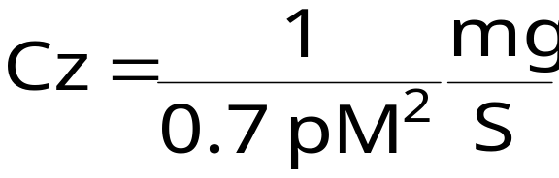
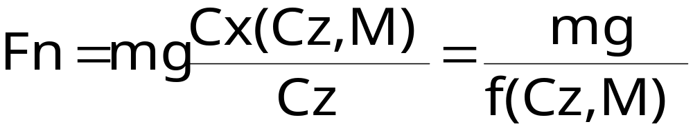
4. Influence of compressibility on thrust required
Lift equation : mg = 0.7 p M² S Cz
  Lift coefficient is a function of Mach number, wing loading and pressure altitude Zp (or static pressure p)
Propulsion equation :
  Drag coefficient Cx and lift over drag ratio f are functions of lift coefficient Cz and Mach number M.
Notes:
IV - <number>
Issue 1 – Feb 2011
IV – High speed performance
Lift equation allows to express lift coefficient, Cz, as a function of kinetic pressure and wing loading.
When kinetic pressure is expressed as a function of Mach number and static pressure, lift coefficient may be expressed as a function of Mach number and static pressure (or pressure altitude Zp), with no influence of temperature.
Required thrust Fn is a function of Mach number and lift coefficient, since lift to drag ratio is a function of lift coefficient and Mach number.

Slide 22
4. Influence of compressibility on thrust required
Drag coefficient evolution with pressure altitude at constant Equivalent Air Speed (EV 235 kt, Cz = 0.6)
Cx/Cx _{incompressible}
FL4OO
1.4
FL35O
FL2OO
FL3OO
FL1OO
1.0
0.4
0.5
0.6
0,7
0.8
Mach
Notes:
IV - <number>
Issue 1 – Feb 2011
IV – High speed performance
This example presents an example of relative increase of drag coefficient as a function of Mach number, for a given lift coefficient.
It must be noticed that, in this example, relative drag increase is negligible below FL200 and lower than 10 % at FL350, but increases steeply above this level, due to drag divergence.

Slide 23
4. Influence of compressibility on thrust required
Evolution of thrust required with pressure altitude
Thrust required
Fn
Zp 30 000 ft
Zp 20 000 ft
Zp 10 000 ft
Zp ≤ 8 000 ft
EV
Notes:
IV - <number>
Issue 1 – Feb 2011
IV – High speed performance
This figure presents evolution of thrust required versus equivalent airspeed curve when altitude increases.
In this example, the sea level curve is valid up to 8000 ft pressure altitude, with slight increase at 10 000 ft. At 20 000 ft, thrust required increase at both higher and lower ends of the curve. At 30 000 ft, thrust required increases significantly in the whole equivalent airspeed range.

Slide 24
4. Influence of compressibility on thrust required
Supersonic airplane thrust diagram
Thrust
Maximum engine thrust
Fu (V)
Sonic
« bump »
Fn (V)
Thrust required
1
2
Mach
Notes:
IV - <number>
Issue 1 – Feb 2011
IV – High speed performance
This slide presents an example of thrust diagram for a supersonic airplane.
Maximum engine thrust usually increase with speed (this is a general characteristic of turbojets or low bypass turbofans).
The sonic « bump » is a consequence of drag divergence. Most supersonic airplanes do not have a supersonic cruise capability, since reheat must be used to overcome drag in the supersonic range (maximum dry thrust is lower than thrust required for level flight).

Slide 25
5. Endurance and range at high altitude
Flight level
FL
Holding speed
At maximum endurance speed, the specific fuel consumption improves when altitude increases (SFC decreases when the F/Fu ratio increases).
Minimum thrust required increases with altitude due to compressibility effects (drag divergence).
300
200
100
0
Fuel flow
Ch
+ 10%
At optimum holding altitude (maximum endurance) those 2 phenomena compensate each other.
Notes:
IV - <number>
Issue 1 – Feb 2011
IV – High speed performance
This slide presents an example of fuel flow evolution with altitude, at holding speed.
At holding speed, when altitude increases, fuel flow decreases due to SFC improvement with altitude (SFC decreases when actual thrust to maximum thrust ratio increases). Above optimum altitude, drag increases due to compressibility effects.
To illustrate the fact that SFC improves when thrust increases, at low altitudes, fuel endurance increases in case of engine failure on a twin engine jet airplane despite the drag increase due to thrust asymmetry.

Slide 26
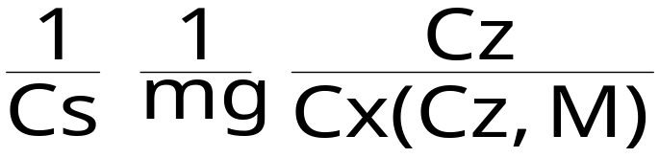
5. Endurance and range at high altitude
Still air specific range may be expressed as a function of Mach number :
Rs = a. M
Assuming constant SFC and constant temperature, maximum specific range is obtained when M.f is maximum.
  Lift over drag ratio f is a function of lift coefficient and Mach number f(Cz,M)
M.f(Cz,M) is maximum for M_{opt} and Cz_{opt} : aerodynamic optimum
Notes:
IV - <number>
Issue 1 – Feb 2011
IV – High speed performance
The formula for still air specific range is obtained by replacing true airspeed by its expression as a function of Mach number.
From the above expression, best specific range at a given mass m, will be obtained for the maximum value of the expression below :
f is the lift over drag ratio, which is a function of lift coefficient and Mach number.
If we assume that specific fuel consumption Cs is constant and that temperature is constant (which is true above 11 000 m or 36 100 ft in ISA conditions), maximum specific range will be obtained for the maximum value of :
M. f (Cz, M)
We can thus define an aerodynamic optimum : Mach number Mopt and lift coefficient Czopt which allow to obtain the best specific range (considering constant SFC and temperature). The values for optimal Mach number Mopt and lift coefficient Czopt are function of the aerodynamic characteristics of the airplane, regardless of engine performance.
If Mach number for cruise is the optimum Mach number, best specific range will be achieved by flying at the optimum altitude corresponding to the optimum lift coefficient, since static pressure p, may be expressed as function of lift coefficient, Mach number and wing loading, according to lift equation :

Slide 27
5. Endurance and range at high altitude
Aerodynamic optimum
Maximum L/D f_{max.}(M)
Best still air specific range
M.f_{max}(M)
M_{opt}
Mach number
M
Notes:
IV - <number>
Issue 1 – Feb 2011
IV – High speed performance
This slide presents the aerodynamic optimum, which, under the assumptions of constant temperature (above 11 000 m in ISA conditions) and constant specific fuel consumption, corresponds to the maximum specific range.
Maximum lift over drag ratio (at a given Mach number) fmax decreases when Mach number increases, due to compressibility effect.
The aerodynamic optimum is given by a Mach number and a lift coefficient M_{opt} and Cz_{opt} defined as follows :
M_{opt} is the Mach number corresponding to the maximum of M.f_{max}(M), where f_{max} is the maximum L/D.
Cz_{opt} is the lift coefficient corresponding to maximum L/D at Mach number M_{opt}.

Slide 28
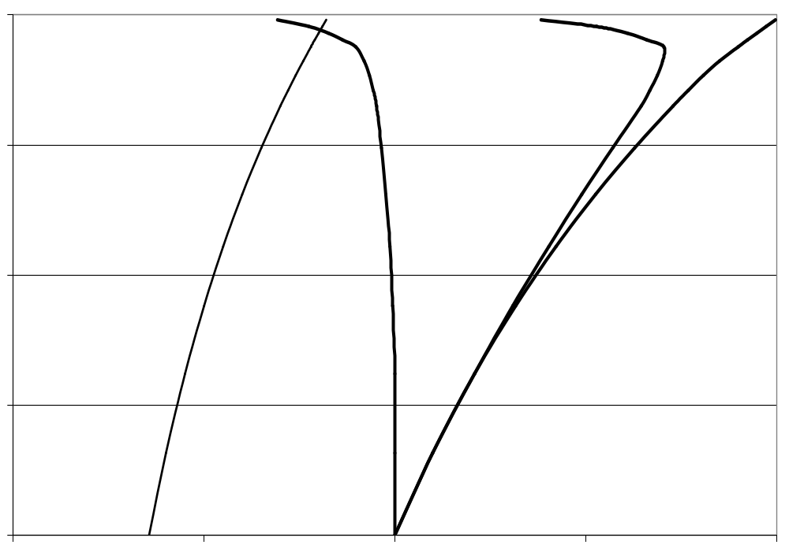
5. Endurance and range at high altitude
Aerodynamic efficiency evolution at constant lift coefficient
Aerodynamic optimum
400
V/V(zp = 0)
300
Mach
V.f / V.f (Zp = 0)
200
f/f(zp= 0)
Flight level FL
100
EV 235 kt
Cz = 0.60
ISA
0
0.0
0.5
1.0
1.5
2.0
Notes:
IV - <number>
Issue 1 – Feb 2011
IV – High speed performance
This slide presents the evolution of aerodynamic efficiency, defined as true airspeed times lift over drag ratio V.f as a function of altitude, at constant lift coefficient (corresponding to an equivalent airspeed at a given aircraft mass). At constant specific fuel consumption (Cs), specific range is proportional to aerodynamic efficiency.
When altitude increases :
True airspeed increases (the slide presents the ratio between true airspeed and equivalent airspeed, (at sea level, true airspeed equals equivalent airspeed).
Mach number increases.
Lift over drag f decreases (the slide presents the ratio between L/D and L/D at sea level).
At lower altitudes, the lift over drag ratio decrease is slow and aerodynamic efficiency increases when altitude, until the altitude corresponding to aerodynamic optimum is reached. Above this altitude, aerodynamic efficiency decreases very quickly.

Slide 29
5. Endurance and range at high altitude
Flight Level
FL
Optimal
altitude
300
« maxi-range »
Mach number
200
EV ≅ constant
100
- 20%
0.6
0.8
Specific range Rs
Mach
Notes:
IV - <number>
Issue 1 – Feb 2011
IV – High speed performance
This slide presents the evolution of « maxi range » cruise conditions for a jet airplane.
The speed corresponding to maximum range, at a given mass, may be approximated by a constant equivalent airspeed at lower altitudes, then a constant Mach number (corresponding to aerodynamic optimum) at higher altitudes.
The optimal altitude, for best specific range, corresponds to the aerodynamic optimum lift coefficient and Mach number.
On this slide, we can see that, at FL 100, specific range is approximately 30 % lower than the optimal specific range (at optimum altitude).

Slide 30
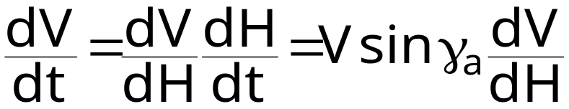
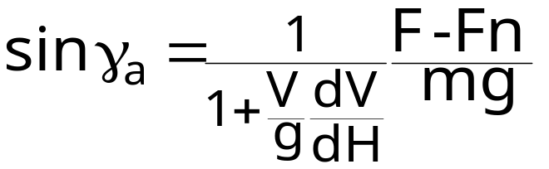
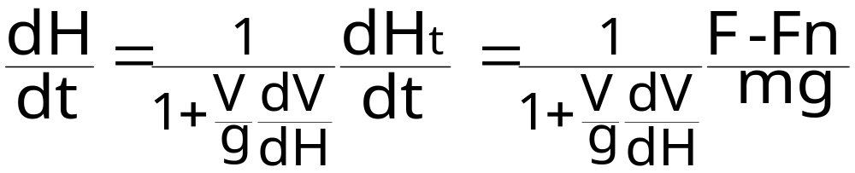
6. Climb at constant Vc/Mach
When climbing at constant calibrated airspeed, Mach number (or equivalent airspeed), true airspeed varies with altitude :
Expressions for climb angle and vertical speed :
Notes:
IV - <number>
Issue 1 – Feb 2011
IV – High speed performance
When climbing at constant CAS or Mach number, true airspeed may vary with altitude :
At constant CAS, true airspeed increases when altitude increases.
At constant Mach number, in ISA conditions, true airspeed decreases below 11 km and is constant above 11 km (at constant Mach number, true airspeed is proportional to the square root of absolute temperature).
Total vertical speed may be expressed as a function of vertical speed and an acceleration term, noted as ε in the expression below :
The acceleration term ε is a function of CAS and pressure altitude, when climbing at constant CAS, and a function of Mach and pressure altitude, when climbing at constant Mach number.

Slide 31


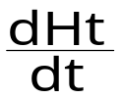
6. Climb at constant Vc/Mach
Zp
Mach 0.79
CAS 300 kt
Constant Mach
below 11 km : < 0
above 11 km : = 0
11 km
36 100 ft
30 000 ft
Constant CAS : > 0
!
Figures valid
in ISA conditions
True Airspeed
V
Example : at FL 300 ; climb at CAS 300 kt = 0.77
climb at Mach 0.79 = 1.09
Notes:
IV - <number>
Issue 1 – Feb 2011
IV – High speed performance
This slide illustrate the influence of the acceleration term on vertical speed.
At FL 300 (30 000 ft pressure altitude), we may compare a climb at constant Mach number (0.79) or at 300 kt CAS, which correspond to the same true airspeed at this altitude (466 kt).
In both cases, total vertical speed will be the same, since it depends only on thrust and drag which are functions of Mach number and pressure altitude.
However, climbing at constant Mach number, TAS decreases when altitude increases, while TAS increases when altitude increases when climbing at constant CAS, which explains a much better vertical speed when climbing at constant Mach number.
Note : The acceleration term may be computed from the expression for TAS as a function of Mach number :
In the case of a climb at constant CAS, the final expression is complex. In the case of a climb at constant Mach number we obtain :

Slide 32
7. High altitude flight envelope
Lift limitation : compressible domain
Outside the incompressible domain, Cz_{max} is a function of the Mach number : Czmax(M)
Lift equation :
  n_{zmax} mg = ½ γ p S M² Cz_{max}(M)
In straight and level flight (nz = 1°
mg = ½ γ p S M² Cz_{nz = 1}
Maximum normal load factor :
n_{zmax} = Cz_{max}(M) / Cz_{nz = 1}
Notes:
IV - <number>
Issue 1 – Feb 2011
IV – High speed performance
Outside the incompressible domain, maximum lift coefficient is a function of Mach number, it is no longer possible to use expressions for stall speed.
Lift coefficient in straight and level flight (n_{z}=1) is a function of mass, Mach number and altitude.
Lift limitation for normal load factor is equal to the ratio between maximum lift coefficient at the relevant Mach number and lift coefficient in straight and level flight.

Slide 33
7. High altitude flight envelope
Maximum lift coefficient in the transonic regime
Cz
Maximum lift coefficient Cz max
Stall / Buffeting limitation
1.0
0.0
0.2
0.3
0.4
0.5
0.6
0.7
0.8
0.9
Mach
Notes:
IV - <number>
Issue 1 – Feb 2011
IV – High speed performance
This slide presents the evolution of maximum lift coefficient as a function of Mach number, for a transonic airplane (cf. chapter dedicated to aerodynamics).
In the transonic regime, maximum lift coefficients decreases sharply towards zero, due to transonic phenomena such as buffet.
In the case of supersonic airplanes, the maximum lift coefficient decreases more slowly towards a positive value.

Slide 34
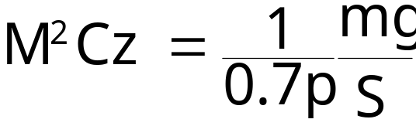
7. High altitude flight envelope
From the lift equation, in straight horizontal flight (n_{z} = 1)
  M².Cz is a function of wing loading and pressure altitude.
The maximum value for M².Czmax(M) defines the lift ceiling :
  for transonic airplanes, the maximum value is usually obtained for a Mach number Mp lower than MMO
  for supersonic airplanes, this value is usually obtained at the maximum Mach number (MMO).
Notes:
IV - <number>
Issue 1 – Feb 2011
IV – High speed performance
In straight horizontal flight, when normal thrust component is neglected, lift must balance weight :
mg = 0.7 p M² S Cz
As a consequence, M²Cz is a function of wing loading and pressure altitude which increases when weight or pressure altitude increase.
In the case of a transonic airplane, M²Cz_{max}(M) presents a maximum value, while it increases continuously in the case of a supersonic airplane.
1
Mp

Slide 35
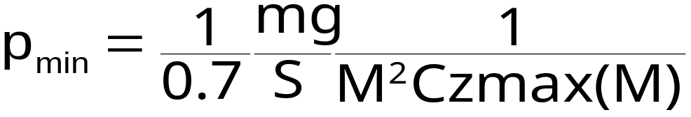
7. High altitude flight envelope
The maximum value for M².Czmax(M) defines the minimum value for static pressure in straight and level flight (n_{z} = 1) :
It is necessary to fly below the lift ceiling in order to keep a minimum load factor margin for maneuvering (nominal value : 1.3 “g”).
It is possible to define a 1.3 “g” ceiling :
p_{1.3g} = 1.3 p_{min}
Notes:
IV - <number>
Issue 1 – Feb 2011
IV – High speed performance
Since M²Cz_{max} is limited to a maximum value, there is a maximum altitude above which lift cannot balance weight : the lift ceiling.
Above the lift ceiling, straight and level flight is not possible. However, it is possible to fly above the lift ceiling, in ballistic flight, keeping normal load factor below 1.
The 1.3 « g » maneuver capability is necessary for two purposes :
To be able to perform turns or pull-ups.
To maintain a minimum envelope in terms of Mach number (cf. next slide). When flying at the lift ceiling there is no margin in terms of normal load factor, as well as in terms of Mach number.
Between 11 km (36 100 ft) and 20 km (65 600 ft), in ISA conditions (constant temperature), a pressure ratio corresponds to a fixed altitude difference : a 1.3 ratio corresponding to 5500 ft :
If the lift ceiling is between 41 600 ft and 65 600 ft, the 1.3 « g » ceiling will be 5500 ft below.

Slide 36
7. High altitude flight envelope
CzM²
Lift limited load factor : n_{zmax} = M²Cz_{max}(M)/CzM²(Zp,m)
Mp²Cz_{max}(Mp)
M²Cz_{max}(M)
Straight level flight (n_{z}=1)
CzM²(Zp,m)
Mach envelope at
altitude Zp and mass m
Mach
Low speed
stall/buffet
M
Mp
High speed
stall/buffet
Notes:
IV - <number>
Issue 1 – Feb 2011
IV – High speed performance
This slide presents the high altitude flight envelope of a transonic airplane. The black curve (Czmax.M² as a function of the Mach number) corresponds to the lift limitation : Cz.M² must be under this maximum value.
The Cz.M² value in straight and level flight (nz =1) is a function of wing loading (A/C weight) and pressure altitude only, which increases with mass and altitude.
To fly straight and level at a given altitude, the corresponding Cz.M² value (red curve) must intersect the black curve (Czmax.M²):
Minimum Mach number is the left intersection, corresponding to the usual low speed stall.
The other intersection corresponds to a high speed stall/buffet, which is specific to the compressible domain.
When altitude increases, the Mach envelope (range between high speed and low speed stall/buffet), decreases.
At a given Mach number in the Mach envelope, maximum normal load factor corresponds to the ratio between Czmax.M² and Cz.M².
Note : The term stall/buffet has been used, since lift may be limited by transonic phenomena such as buffet or handling qualities instabilities.

Slide 37
7. High altitude flight envelope
Lift ceiling : function of weight (does not depend on temperature). Operational limit is 1.3 “g” ceiling.
Propulsion ceiling : function of weight and temperature.
Operational limit allows for a minimum climb rate (ex. 300 ft/mn).
Maximum operating altitude : limited by pressurization/oxygen.
Notes:
IV - <number>
Issue 1 – Feb 2011
IV – High speed performance
The lift ceiling is defined in the chapter dedicated to climb performance while the propulsion ceiling is defined in the chapter dedicated to maneuvering performance.
The maximum operating altitude is an operating limitation defined by airworthiness regulations. For commercial airplanes, maximum operating altitude is usually constrained by pressurization requirements (for commercial airplanes certified under FAR/JAR25, the pressurization system must be able to maintain a cabin altitude lower than 8000 ft up to the maximum operating altitude).

Slide 38
7. High altitude flight envelope
High altitude flight envelope (commercial jet)
430
Buffeting limitation
(1 « g » lift limitation)
1 « g » Propulsion
limitation
390
Maximum operating
altitude
Flight Level
300 ft/mn
climb limitation
MMO 0.82
350
1.3 « g »
maneuvering limitation
Operational
flight envelope
310
0.65
0.70
0.75
0.80
Mach
Notes:
IV - <number>
Issue 1 – Feb 2011
IV – High speed performance
This slide presents the flight envelope of a commercial jet at high altitude.
On this slide several boundaries are presented :
The maximum operating altitude.
The buffeting limitation (1 « g » lift – weight equilibrium), defining the lift ceiling.
The 1.3 « g » maneuvering limitation, allowing for 1.3 normal load factor.
The propulsion limitation (thrust – drag equilibrium), defining the propulsion limit.
The 300 ft/mn climb limitation, allowing for climb at 300 ft/mn.
The operational flight envelope is constrained by the maximum operating altitude, the 1.3 « g » maneuvering limit and the 300 ft/mn climb limitation. The operational flight envelope is a function of A/C mass and outside air temperature since :
Buffeting limitation and 1.3 « g » maneuvering limitation are functions of A/C mass.
Propulsion limitation and 300 ft/mn climb limitation are functions of A/C mass and outside air temperature.

Slide 39
7. High altitude flight envelope
Supersonic fighter flight envelope
Ht 80 kft
Ht 100 kft
Max.
energy
600
extended flight
envelope
Lift limitation (Cz max)
Mach 2.1
Propulsion limitation
Thrust = Drag
Flight level (FL)
Ht 60 kft
400
1 « g » flight
envelope
Ht 40 kft
750 kt CAS
200
Lift limitation
Ht 20 kft
700 kt CAS
0
0
400
TAS (kt)
800
1200
Notes:
IV - <number>
Issue 1 – Feb 2011
IV – High speed performance
This slide presents the flight envelope of a Mach 2 class supersonic fighter.
Maximum speed is constrained by :
Maximum CAS : 700 kt below 20 000 ft, 750 kt above 20 000 ft,
Mach 2.1
1 « g » Flight envelope is also constrained by lift limitation and propulsion limitation.
Constant total altitude lines are presented : while propulsion ceiling is 53 000 ft, maximum energy corresponds to a total altitude above
100 000 ft.
It is possible to trade kinetic energy for potential energy to climb above propulsion ceiling while remaining below the lift ceiling (extended flight envelope). Such maneuvers, called « zooms » are used to beat absolute altitude records : airplanes such as Lockheed SR-71 and Mikoyan Mig-25/E-266 have reached altitudes above 37000 m 120 000 ft, while limited below 90 000 ft in sustained horizontal flight.
Note : If it were possible to trade all kinetic energy for potential energy, it would be possible to reach the total altitude corresponding to maximum energy. However, this is not possible due to the energy losses during the maneuver, the requirement to keep a minimum speed for controls efficiency and engines shutdown of at higher altitudes.

Slide 40
7. High altitude flight envelope
Supersonic fighter flight envelope : optimum climb
Mach 1.0
0 ft/mn
F
F
5 kft/mn
400
E
Flight Level (FL )
15 kft/mn
10 kft/mn
C
C
15 kft/mn
200
Constant
SEP lines
20 kft/mn
25 kft/mn
D
30 kft/mn
0
A
B
200
400
600
800
1000
1200
TAS (kts )
Notes:
IV - <number>
Issue 1 – Feb 2011
IV – High speed performance
This slide presents trajectory optimization within the flight envelope.
In the flight envelope depicted on the previous slide, constant specific excess power lines are presented :
Maximum specific excess power (B), is over 30 000 ft/mn,
The 0 ft/mn line is the propulsion limitation (propulsion ceiling).
The trajectory from A to F presents a simple solution approximation to a complex problem : how to get from A (0 ft / 300 kt TAS), to F (50 000 ft / 1100 kt TAS) in the minimum time.
The depicted trajectory obtained by climbing along maximum SEP lines, for maximum total rate of climb and constant total energy lines :
Acceleration in level flight from A to B, to reach maximum SEP as quickly as possible.
Climb along maximum SEP lines from B to C.
Dive at constant energy from C to D : this allows for acceleration through the sonic region as quickly as possible to minimize the penalty due to high drag.
Climb along maximum SEP lines from D to E.
Climb at constant energy from E to F.

Slide 41
8. Mach number limitations
High speed buffet (transonic A/C)
Handling qualities considerations (stability and control)
Air intakes flow (supersonic A/C)
Skin temperature : Tt = (1 + 0.2 M²)T
Operational limitation : MMO
Notes:
IV - <number>
Issue 1 – Feb 2011
IV – High speed performance
For transonic airplanes, Mach number must be limited to avoid transonic phenomena such as high speed buffet, which may be encountered at high Mach numbers.
Supersonic airplanes, due to thin airfoils (and eventually high swept wings), do not encounter buffet through the sonic region. However, Mach number may be limited by air intake design and by skin temperature.
Note : Fixed geometry air intakes may be used for supersonic airplanes, but at a price of an efficiency loss above Mach 1.5. Variable geometry air intakes were used on previous supersonic fighters (Mirage III, Mirage F1, F-4 « Phantom », etc) which were able to fly at Mach 2. More recent fighters have fixed geometry air intakes for lower weight, but are restricted below Mach 2.
For civil airplanes, maximum operating Mach number is MMO, it should be lower than the maximum design Mach number MD. According to FAR/JAR 25, an acceptable method to define MD is to use: MD = MMO + 0.07.

Slide 42
8. Mach number limitations
Total temperature for – 56.5° C static temperature
°C
400
300
200
Limit for aluminum alloys
100
0
0
1
2
3
-100
Mach
Notes:
IV - <number>
Issue 1 – Feb 2011
IV – High speed performance
This slide presents total temperature as a function of Mach number, for a – 56.5°C / 216.65 K static temperature (ISA temperature between 11 and 20 km).
This temperature is reached at stagnation points (nose, leading edges, etc) with lower skin temperatures at other parts.
The 150°C limit for aluminum alloys is reached for Mach 2.2, as a consequence, other materials must be used to fly above this speed :
Titanium is used on high speed airplanes such as the SR71
Tiles made of abrasive materials are used on the space shuttle.

Slide 43
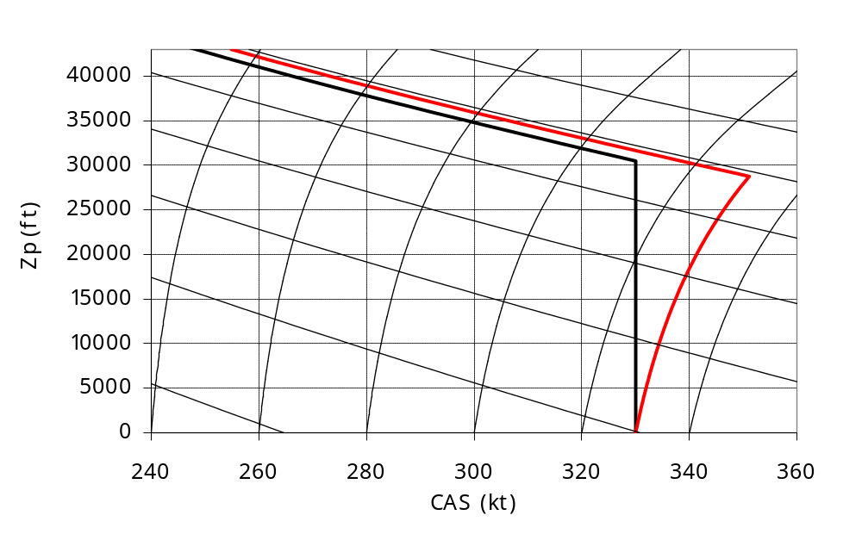
8. Mach number limitations
Mach number and calibrated airspeed limitations
Mach 1.0
Mach 0.9
MMO 0.87
EAS 320 kt
MMO 0.89
EAS 240 kt
Mach 0.8
EAS 260 kt
EAS 280 kt
Mach 0.7
EAS 340 kt
Mach 0.6
EAS 300 kt
VMO 330 kt
VMO : EAS 330 kt
B777-200 ER
B777-300 ER
Mach 0.5
Notes:
This figure presents two examples of VMO/MMO speed limitations :
For the Boeing B777-200 ER, VMO is 330 kt (IAS) and MMO is 0.87. The crossover altitude (altitude corresponding to VMO/MMO intersection) is 30 480 ft. Above crossover altitude, speed is limited by MMO, while speed is limited by VMO below crossover altitude.
For the Boeing B777-300 ER, MMO is 0.89 and VMO increases with altitude, corresponding to 330 kt equivalent airspeed (VMO is 330 kt CAS at sea level and 351 kt CAS at crossover altitude, 28 755 ft).
It should be stressed that maximum true airspeed is obtained at crossover altitude corresponding to VM0/MMO intersection :
below crossover altitude, at constant calibrated airspeed (or equivalent airspeed, if VMO varies with altitude), true airspeed increases with altitude,
above crossover altitude, at constant Mach number, true airspeed decreases with altitude in ISA conditions (or is constant if crossover altitude is higher than 11 km/36 100 ft).
A variable VMO, corresponding to constant equivalent airspeed allows to increase flight envelope with a minimal structural penalty, since maximum kinetic pressure does not increase.

